Slide 1
MOVIE MONK TICKET ANALYSIS
PRESENTED BY:
Pratikesh Sampale

Slide 2
AIM
To perform EDA on the Ticket booking on Movie Monk platform. You will be using Tableau Public / Desktop to answer the hidden questions and identify Key Performance Indicators.
You will learn certain data cleaning and manipulation actions while drawing insights from the dataset. On completing you are expected to share your views along with Story.

Slide 3
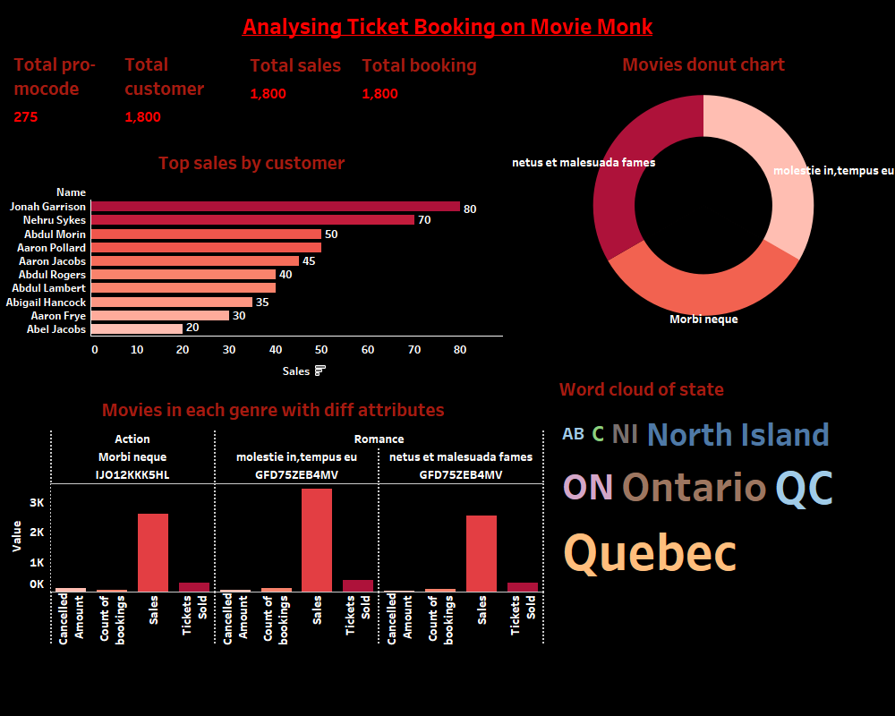
MOVIE MONK ANALYSIS

Slide 4
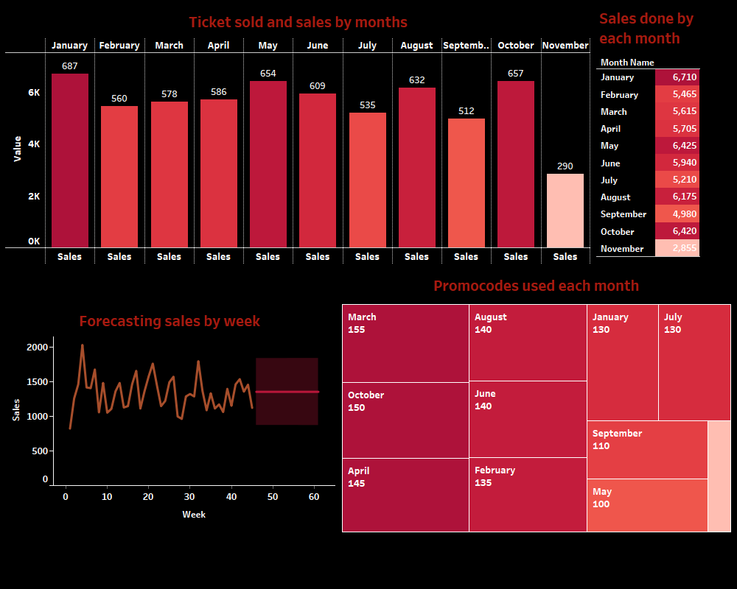
MOVIE MONK ANALYSIS

Slide 5
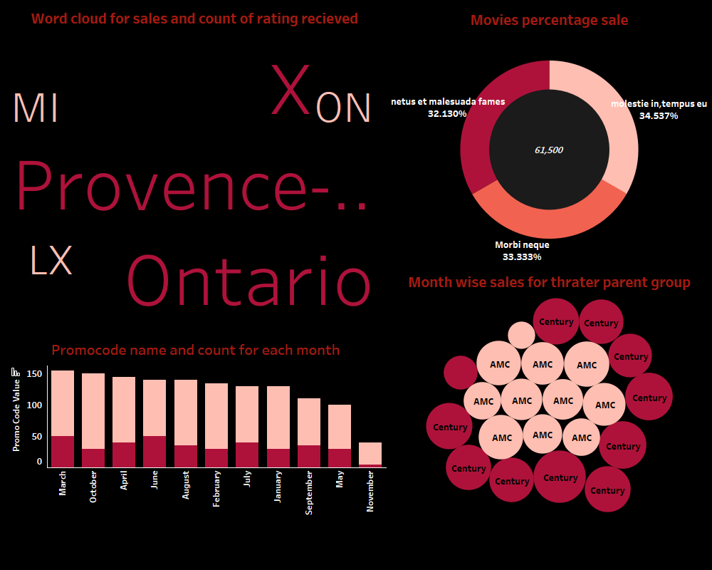
MOVIE MONK ANALYSIS

Slide 6
CONCLUSION
January , may , august , October have high ticket sold and sales
Johan garrison ,Nehru sykes has a high sale customers
The highest promocode is used in march, October and april

Slide 7
THANK YOU

